Slide 1
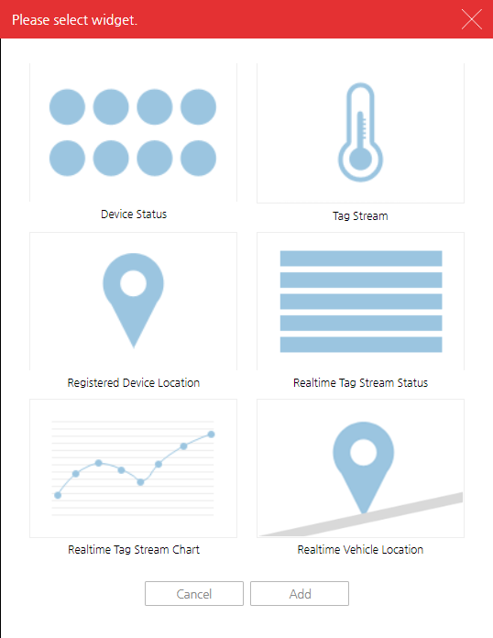
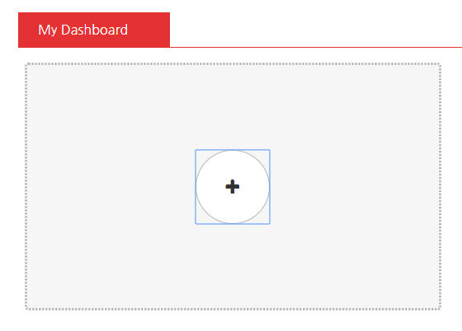
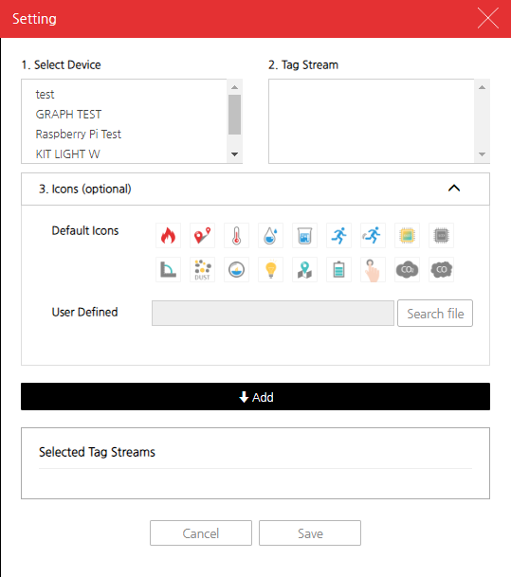
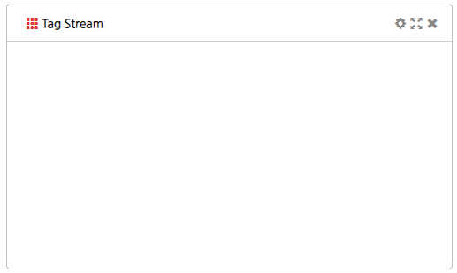
1. IoT Development -> My Dashboard
2. Click “Tag Stream” and “Add” button
3. Click “Setting” button

Slide 2
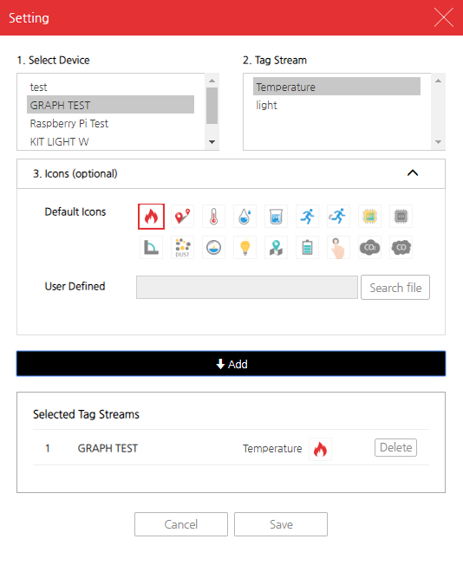
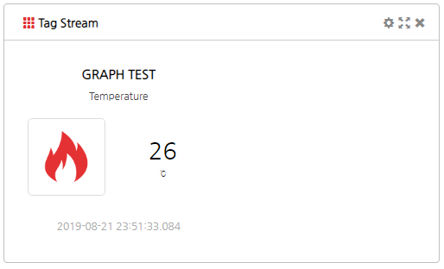
4. Select Device -> Tag Stream -> Icons -> Click “Add” Button -> Click “Save” Button
5. Do something else

